Slide 1
An Accelerating Cosmological Model from a Parametrization of Hubble Parameter
Shibesh Kumar Jas Pacif
Department of Mathematics, School of Advanced Sciences
Vellore Institute of Technology, Vellore, Tamil Nadu 632014, India
10th Mathematical Physics Meeting: School and Conference on Modern Mathematical Physics
Belgrade, Serbia 09-14 September 2019

Slide 2
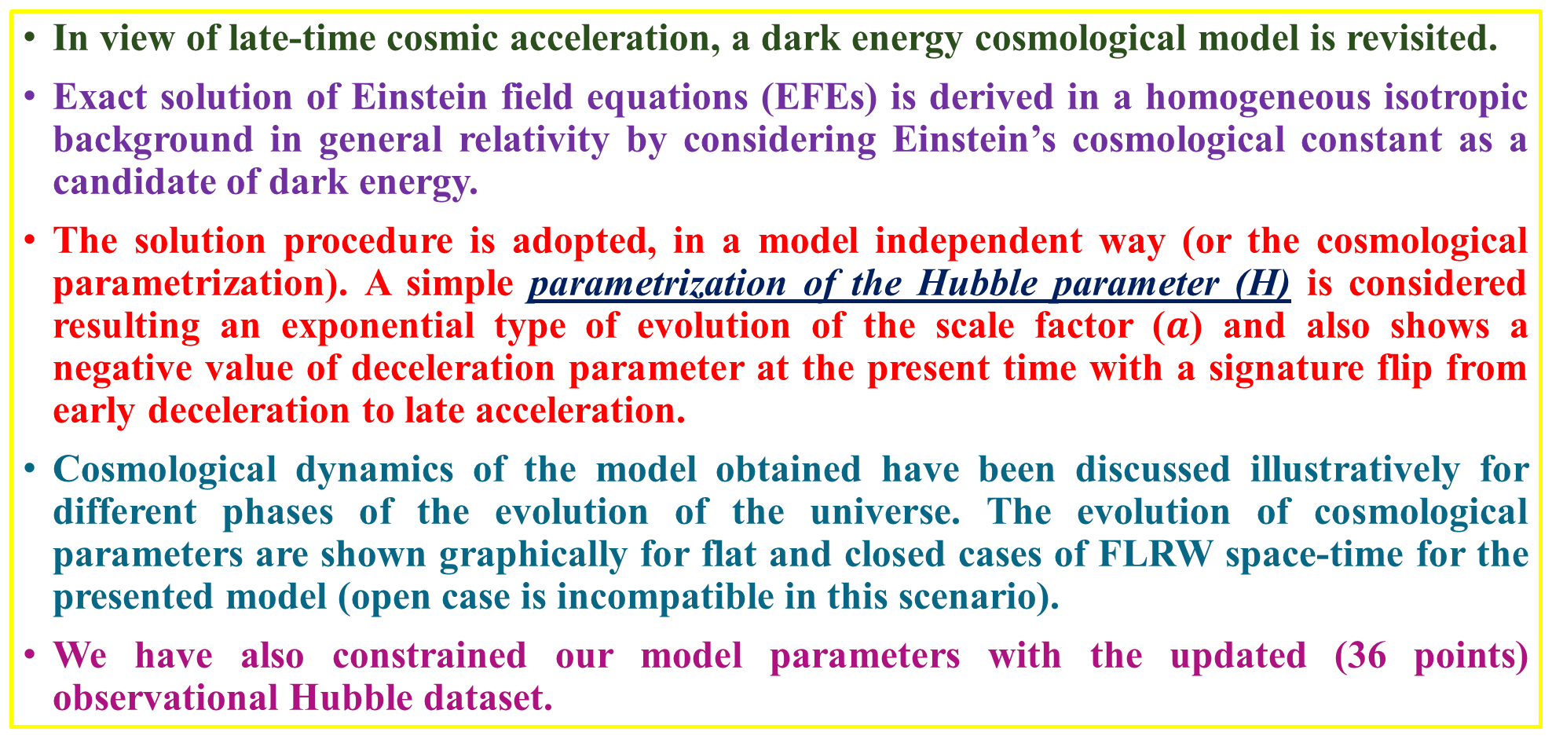
OUTLINES
In view of late-time cosmic acceleration, a dark energy cosmological model is revisited.
Exact solution of Einstein field equations (EFEs) is derived in a homogeneous isotropic background in general relativity by considering Einstein’s cosmological constant as a candidate of dark energy.
The solution procedure is adopted, in a model independent way (or the cosmological parametrization). A simple parametrization of the Hubble parameter (H) is considered resulting an exponential type of evolution of the scale factor ($a$) and also shows a negative value of deceleration parameter at the present time with a signature flip from early deceleration to late acceleration.
Cosmological dynamics of the model obtained have been discussed illustratively for different phases of the evolution of the universe. The evolution of cosmological parameters are shown graphically for flat and closed cases of FLRW space-time for the presented model (open case is incompatible in this scenario).
We have also constrained our model parameters with the updated (36 points) observational Hubble dataset.

Slide 3
Introduction
There exist some fundamental issues on Standard Big Bang Cosmology (SBBC) such as cosmological constant problem, singularity problem, age problem and also the standard model exhibits all time decelerating expansion.
The discovery of accelerating expansion raised some questions on SBBC. To resolve some of these issues DARK ENERGY is introduced which is quite successful to explain some observable properties of the Universe.
Einstein field equations in FLRW background contains two independent equations with three unknowns (energy density-ρ, pressure-p and scale factor-a) which can be solved by assuming the equation of state. With the addition of an extra degree of freedom - dark energy, the system becomes undeterminable.
There exists a number of ways to deal with this inconsistency in literature. We, here adopt a very simple mathematical approach to find the exact solution of the field equations known as model independent way or cosmological parametrization.
We parametrize the functional form of Hubble parameter and study the dynamics of the Universe in view of the late-time cosmic acceleration.

Slide 4
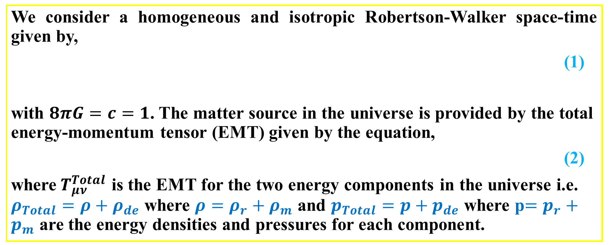
BASIC EQUATIONS AND SOLUTION OF FIELD EQUATIONS
A. Field Equations
We consider a homogeneous and isotropic Robertson-Walker space-time given by,
(1)
with $8πG=c=1$. The matter source in the universe is provided by the total energy-momentum tensor (EMT) given by the equation,
(2)
where$T_{μν}^{Total}$ is the EMT for the two energy components in the universe i.e. $ρ_{Total}=ρ+ρ_{de}$ where $ρ=ρ_{r}+ρ_{m}$ and $p_{Total}=p+p_{de}$ where p$=p_{r}+p_{m}$ are the energy densities and pressures for each component.

Slide 5
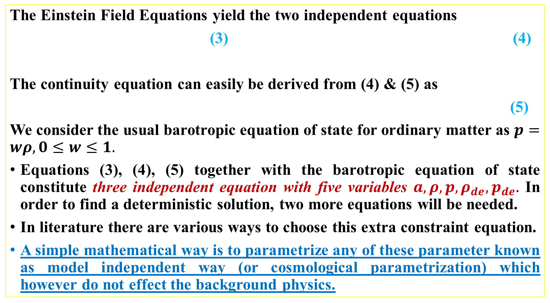
The Einstein Field Equations yield the two independent equations
(3) (4)
The continuity equation can easily be derived from (4) & (5) as
(5)
We consider the usual barotropic equation of state for ordinary matter as $p=wρ, 0≤w≤1.$
Equations (3), (4), (5) together with the barotropic equation of state constitute three independent equation with five variables $a, ρ, p, ρ_{de}, p_{de}.$ In order to find a deterministic solution, two more equations will be needed.
In literature there are various ways to choose this extra constraint equation.
A simple mathematical way is to parametrize any of these parameter known as model independent way (or cosmological parametrization) which however do not effect the background physics.

Slide 6
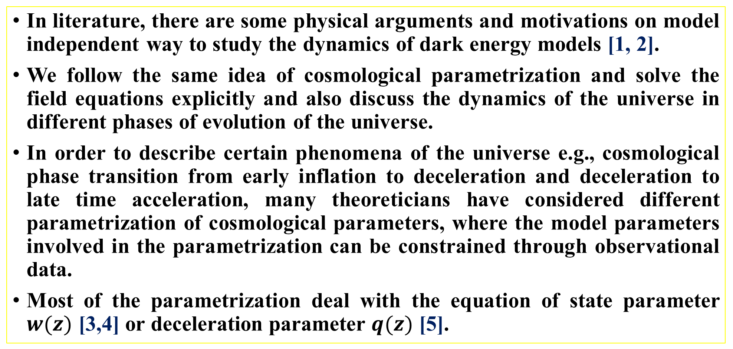
B. Parametrization of H
In literature, there are some physical arguments and motivations on model independent way to study the dynamics of dark energy models [1, 2].
We follow the same idea of cosmological parametrization and solve the field equations explicitly and also discuss the dynamics of the universe in different phases of evolution of the universe.
In order to describe certain phenomena of the universe e.g., cosmological phase transition from early inflation to deceleration and deceleration to late time acceleration, many theoreticians have considered different parametrization of cosmological parameters, where the model parameters involved in the parametrization can be constrained through observational data.
Most of the parametrization deal with the equation of state parameter $w(z)$ [3,4] or deceleration parameter $q(z)$ [5].

Slide 7
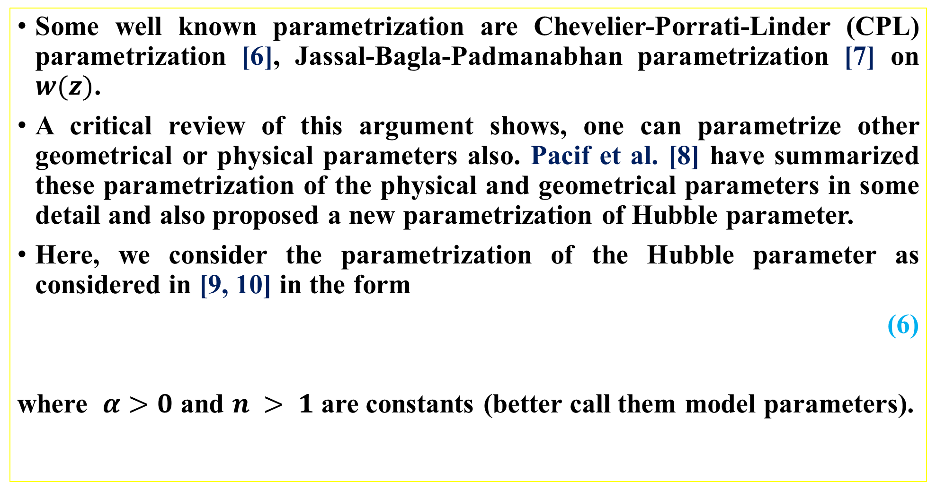
Some well known parametrization are Chevelier-Porrati-Linder (CPL) parametrization [6], Jassal-Bagla-Padmanabhan parametrization [7] on $w(z)$.
A critical review of this argument shows, one can parametrize other geometrical or physical parameters also. Pacif et al. [8] have summarized these parametrization of the physical and geometrical parameters in some detail and also proposed a new parametrization of Hubble parameter.
Here, we consider the parametrization of the Hubble parameter as considered in [9, 10] in the form
(6)
where $α>0$ and $n > 1$ are constants (better call them model parameters).

Slide 8
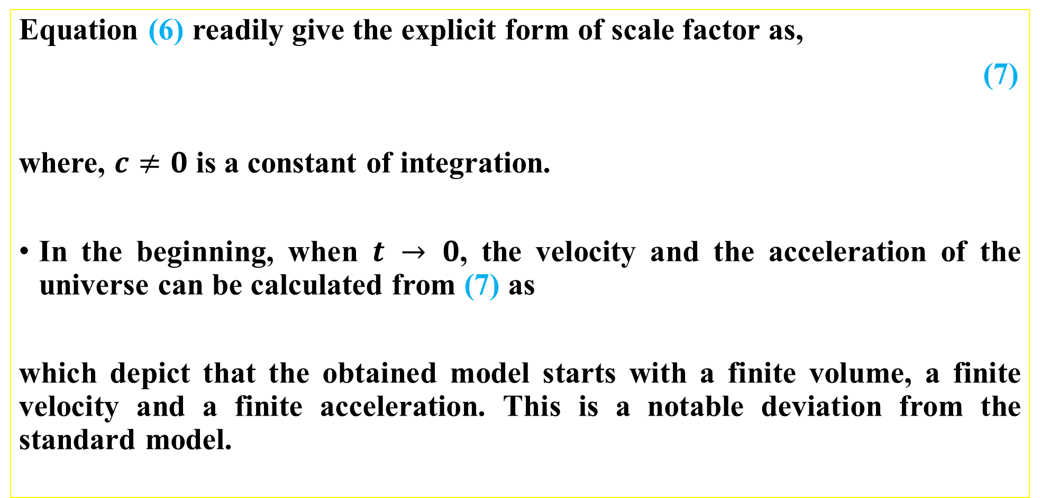
C. Geometrical interpretation of the model
Equation (6) readily give the explicit form of scale factor as,
(7)
where, $c≠0$ is a constant of integration.
In the beginning, when $t → 0$, the velocity and the acceleration of the universe can be calculated from (7) as
which depict that the obtained model starts with a finite volume, a finite velocity and a finite acceleration. This is a notable deviation from the standard model.

Slide 9
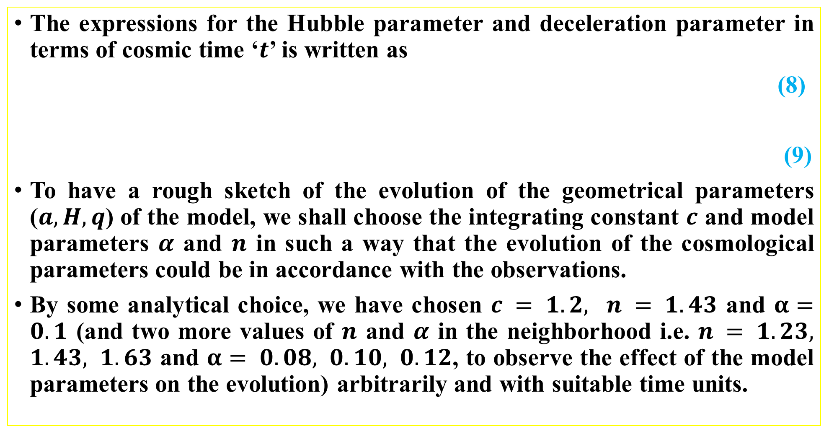
The expressions for the Hubble parameter and deceleration parameter in terms of cosmic time ‘$t$’ is written as
(8)
(9)
To have a rough sketch of the evolution of the geometrical parameters ($a, H, q$) of the model, we shall choose the integrating constant $c$ and model parameters $α$ and $n$ in such a way that the evolution of the cosmological parameters could be in accordance with the observations.
By some analytical choice, we have chosen $c = 1.2, n = 1.43$ and $α=0.1$ (and two more values of $n$ and $α$ in the neighborhood i.e. $n = 1.23, 1.43, 1.63$ and $α= 0.08, 0.10, 0.12$, to observe the effect of the model parameters on the evolution) arbitrarily and with suitable time units.

Slide 11
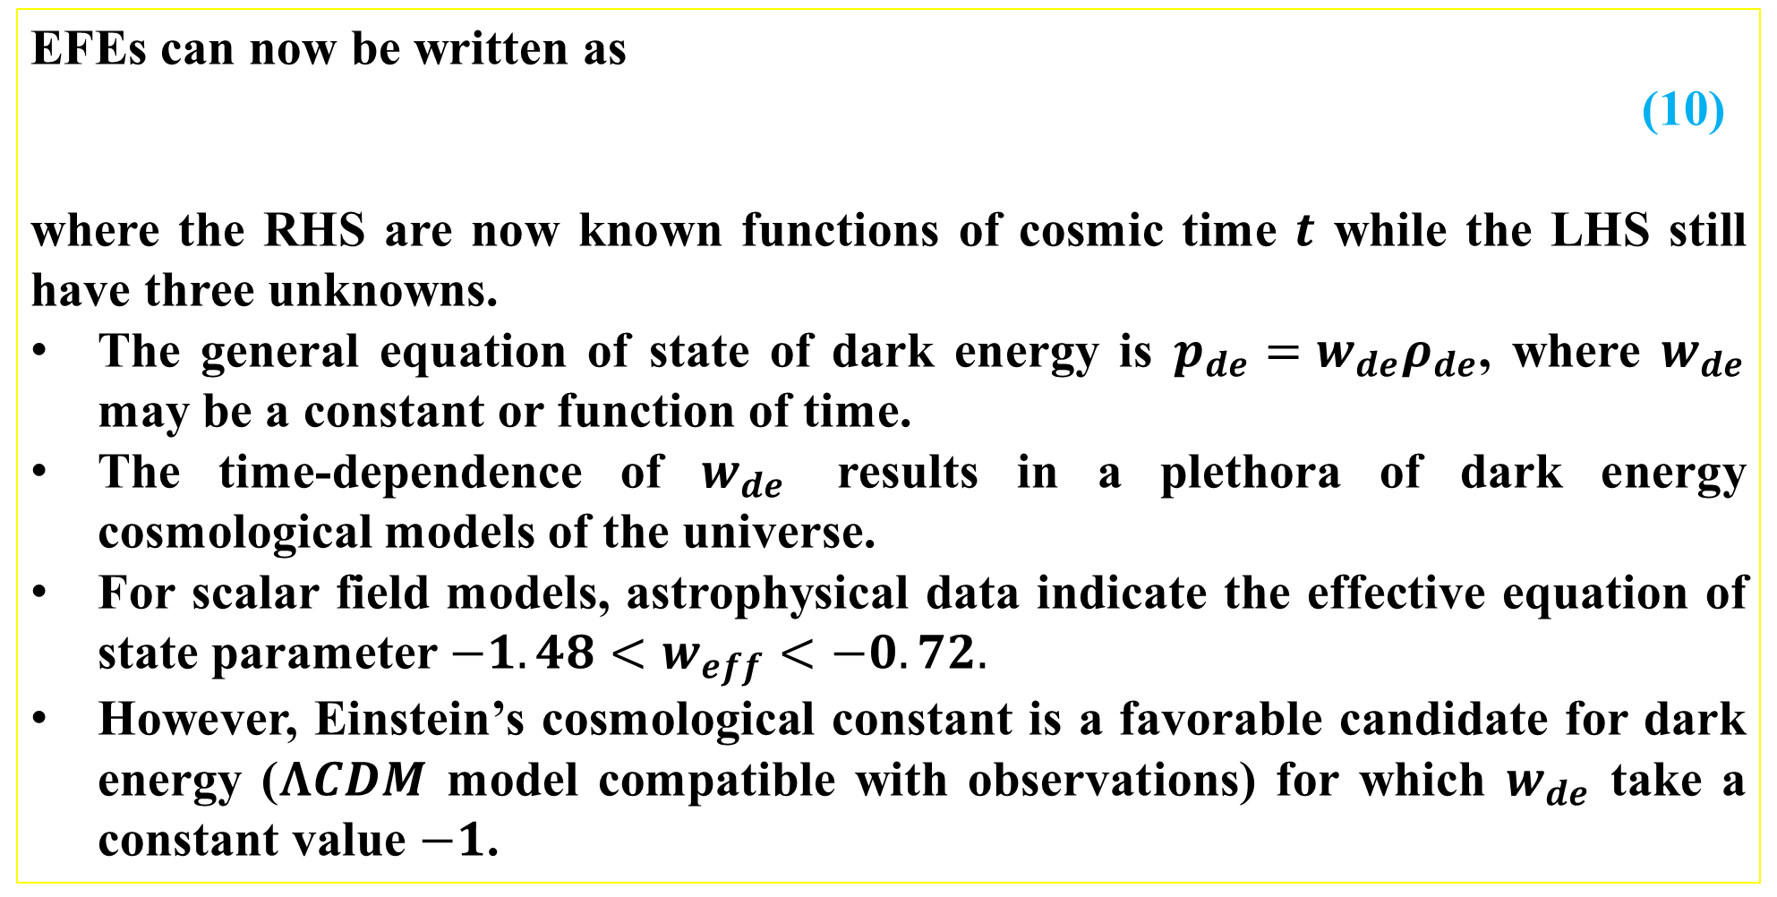
DYNAMICS AND PHYSICAL INTERPRETATION OF THE MODEL
EFEs can now be written as
(10)
where the RHS are now known functions of cosmic time $t$ while the LHS still have three unknowns.
The general equation of state of dark energy is $p_{de}=w_{de}ρ_{de}$, where $w_{de}$ may be a constant or function of time.
The time-dependence of $w_{de}$ results in a plethora of dark energy cosmological models of the universe.
For scalar field models, astrophysical data indicate the effective equation of state parameter $−1.48<w_{eff}<−0.72.$
However, Einstein’s cosmological constant is a favorable candidate for dark energy ($ΛCDM$ model compatible with observations) for which $w_{de}$ take a constant value $−1$.

Slide 12
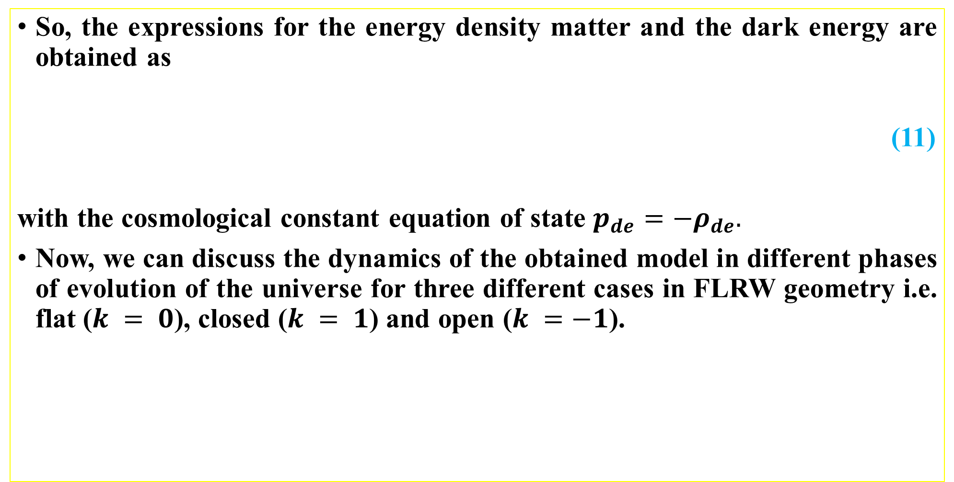
So, the expressions for the energy density matter and the dark energy are obtained as
(11)
with the cosmological constant equation of state $p_{de}=−ρ_{de}.$
Now, we can discuss the dynamics of the obtained model in different phases of evolution of the universe for three different cases in FLRW geometry i.e. flat ($k = 0$), closed ($k = 1$) and open ($k =−1$).

Slide 13
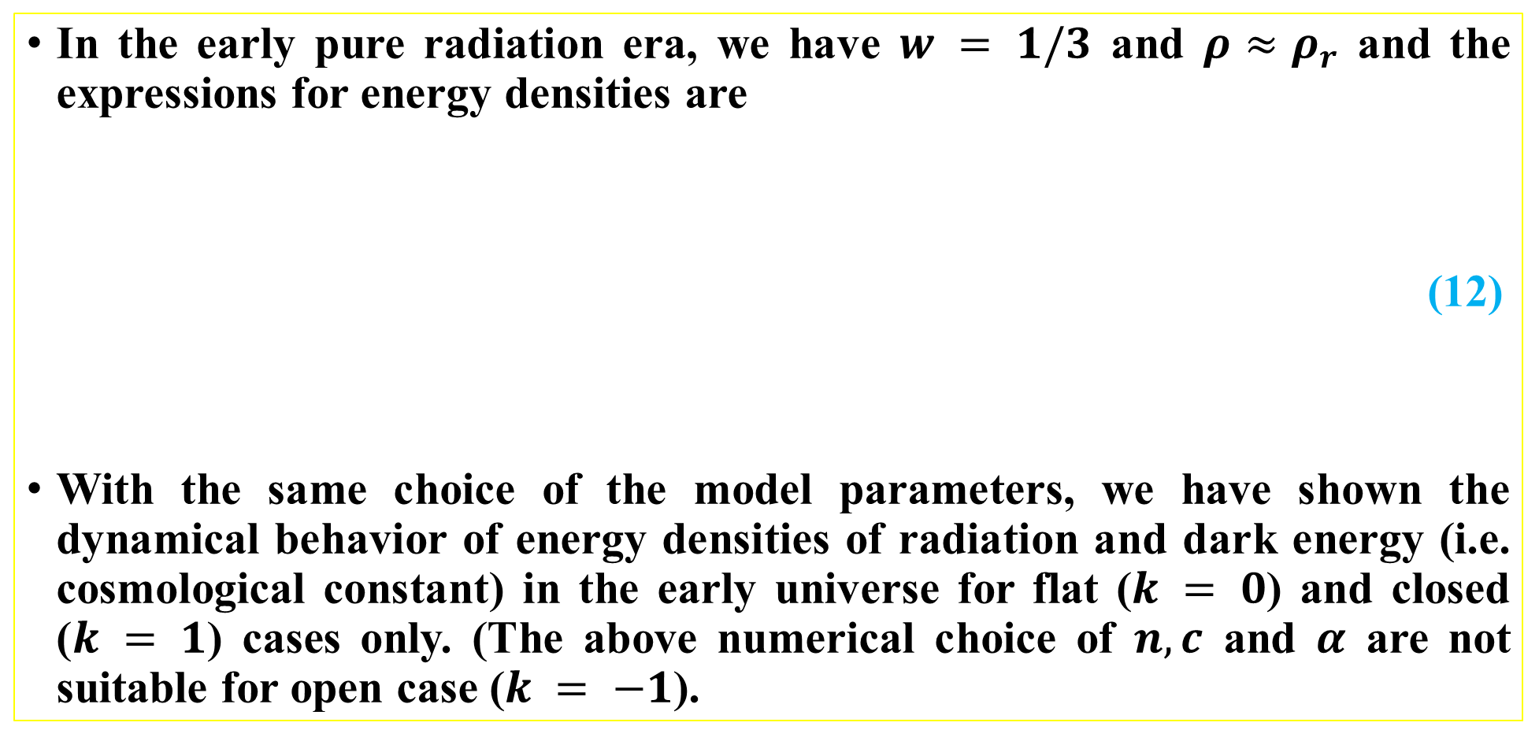
A. Radiation Dominated Universe
In the early pure radiation era, we have $w = 1/3$ and $ρ≈ρ_{r}$ and the expressions for energy densities are
(12)
With the same choice of the model parameters, we have shown the dynamical behavior of energy densities of radiation and dark energy (i.e. cosmological constant) in the early universe for flat ($k = 0$) and closed ($k = 1$) cases only. (The above numerical choice of $n, c$ and $α$ are not suitable for open case ($k = −1$).

Slide 16
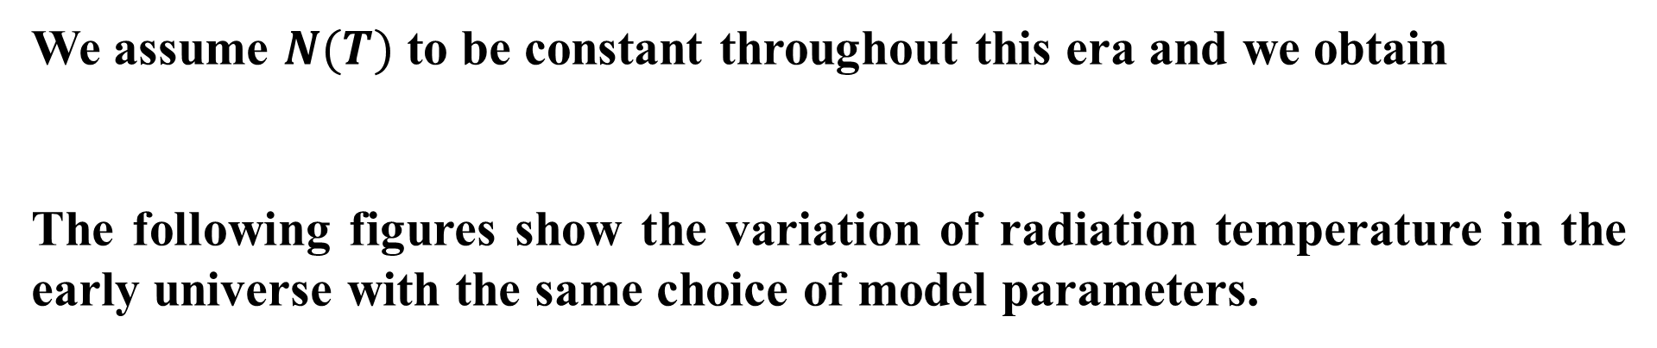

The radiation energy density and the temperature ($T$) are related by the relation
We assume $N(T)$ to be constant throughout this era and we obtain
The following figures show the variation of radiation temperature in the early universe with the same choice of model parameters.

Slide 18
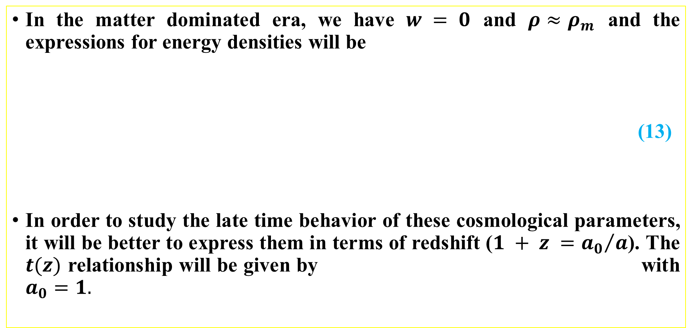
B. Matter Dominated Universe
In the matter dominated era, we have $w = 0$ and $ρ≈ρ_{m}$ and the expressions for energy densities will be
(13)
In order to study the late time behavior of these cosmological parameters, it will be better to express them in terms of redshift ($1 + z ={a_{0}}/a$). The $t(z)$ relationship will be given by with $a_{0}=1.$

Slide 19

So, the Hubble parameter $H$ can be written in terms of redshift as
or
where $H_{0}$ is the present value of the Hubble parameter.
The following figures show the dynamical behavior of the energy densities in near past and late-time universe. The plots are in terms of redshift $z$. In all cases they are decreasing to very small values.

Slide 20
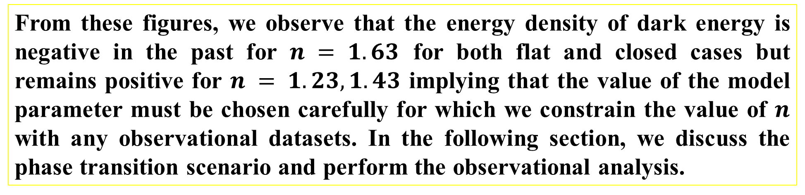
From these figures, we observe that the energy density of dark energy is negative in the past for $n = 1.63$ for both flat and closed cases but remains positive for $n = 1.23, 1.43$ implying that the value of the model parameter must be chosen carefully for which we constrain the value of $n$ with any observational datasets. In the following section, we discuss the phase transition scenario and perform the observational analysis.

Slide 21
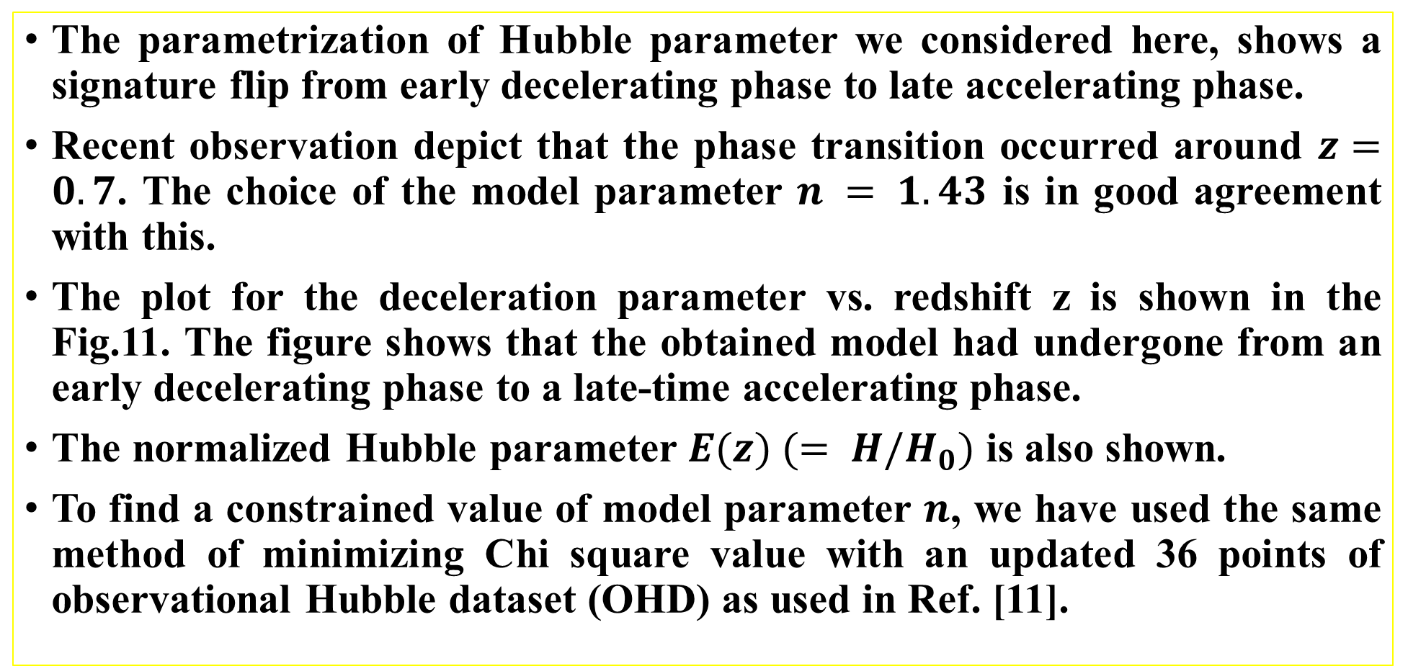
C. Dec-Acc Phase Transition & H(z) Observation
The parametrization of Hubble parameter we considered here, shows a signature flip from early decelerating phase to late accelerating phase.
Recent observation depict that the phase transition occurred around $z=0.7$. The choice of the model parameter $n = 1.43$ is in good agreement with this.
The plot for the deceleration parameter vs. redshift z is shown in the Fig.11. The figure shows that the obtained model had undergone from an early decelerating phase to a late-time accelerating phase.
The normalized Hubble parameter $E(z) (= H/H_{0})$ is also shown.
To find a constrained value of model parameter $n$, we have used the same method of minimizing Chi square value with an updated 36 points of observational Hubble dataset (OHD) as used in Ref. [11].

Slide 23
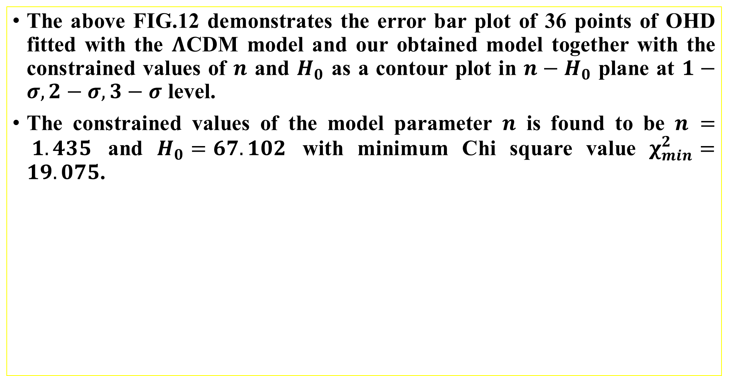
The above FIG.12 demonstrates the error bar plot of 36 points of OHD fitted with the $Λ$CDM model and our obtained model together with the constrained values of $n$ and $H_{0}$ as a contour plot in $n−H_{0}$ plane at $1−σ, 2−σ, 3−$ $σ$ level.
The constrained values of the model parameter $n$ is found to be $n = 1.435$ and $H_{0}=67.102$ with minimum Chi square value $χ_{min}^{2}=19.075$.

Slide 24
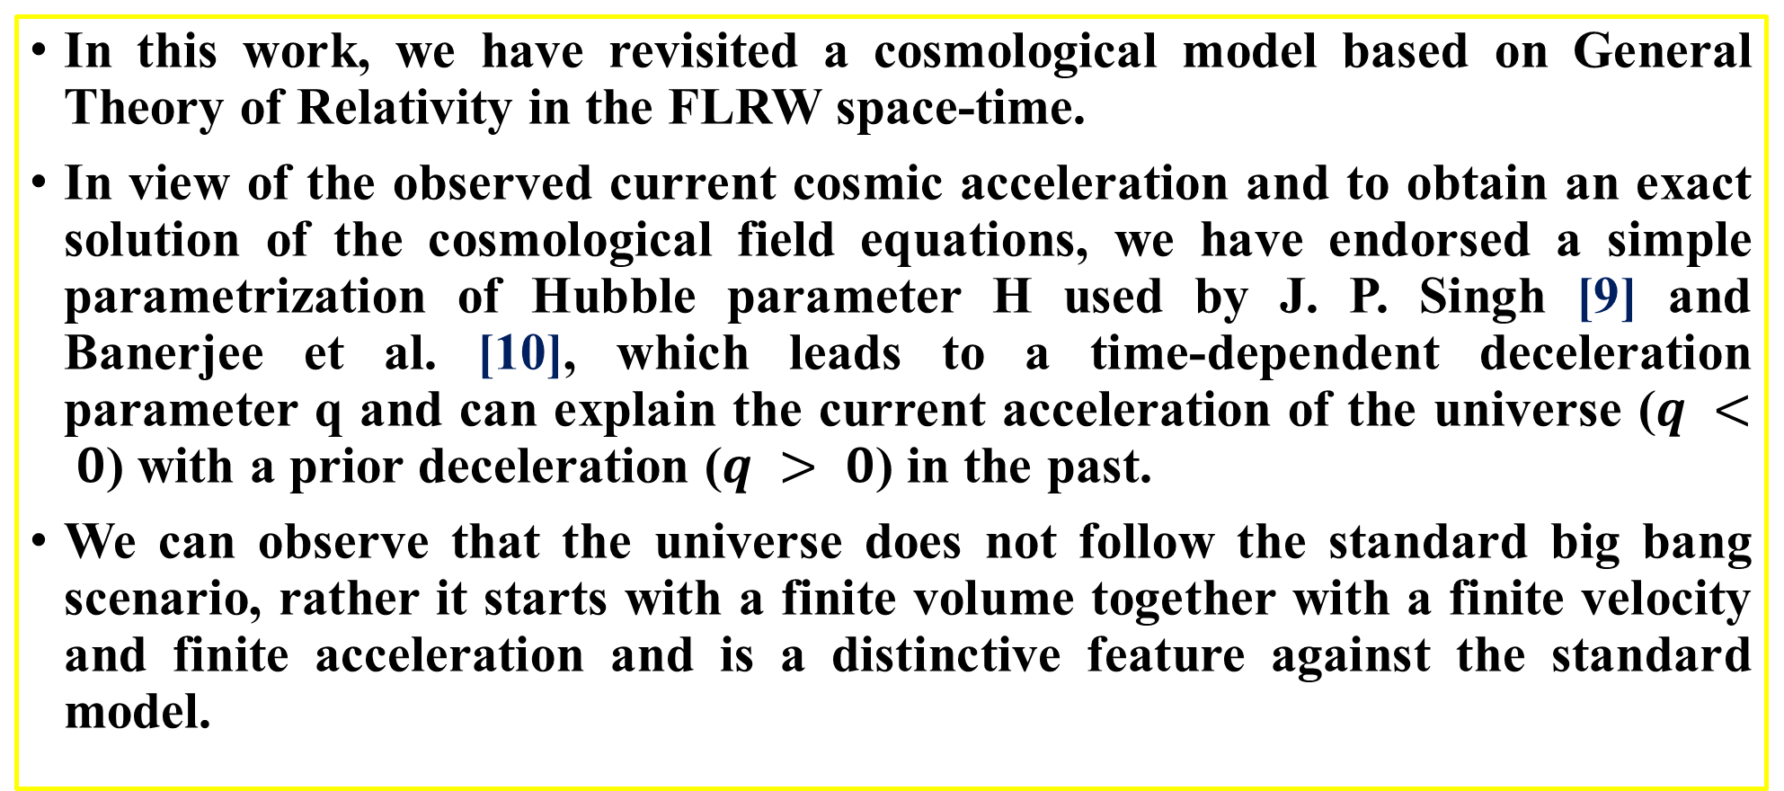
CONCLUDING REMARKS & FUTURE SCOPE
In this work, we have revisited a cosmological model based on General Theory of Relativity in the FLRW space-time.
In view of the observed current cosmic acceleration and to obtain an exact solution of the cosmological field equations, we have endorsed a simple parametrization of Hubble parameter H used by J. P. Singh [9] and Banerjee et al. [10], which leads to a time-dependent deceleration parameter q and can explain the current acceleration of the universe ($q < 0$) with a prior deceleration ($q > 0$) in the past.
We can observe that the universe does not follow the standard big bang scenario, rather it starts with a finite volume together with a finite velocity and finite acceleration and is a distinctive feature against the standard model.

Slide 25
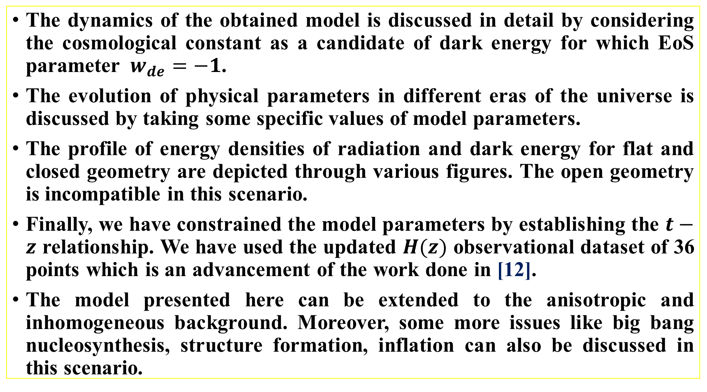
The dynamics of the obtained model is discussed in detail by considering the cosmological constant as a candidate of dark energy for which EoS parameter $w_{de}=−1$.
The evolution of physical parameters in different eras of the universe is discussed by taking some specific values of model parameters.
The profile of energy densities of radiation and dark energy for flat and closed geometry are depicted through various figures. The open geometry is incompatible in this scenario.
Finally, we have constrained the model parameters by establishing the $t−z$ relationship. We have used the updated $H(z)$ observational dataset of 36 points which is an advancement of the work done in [12].
The model presented here can be extended to the anisotropic and inhomogeneous background. Moreover, some more issues like big bang nucleosynthesis, structure formation, inflation can also be discussed in this scenario.

Slide 26
Recently, a robust method based on the redshift dependence of Alcock-Paczynski test is developed in [13] to measure the expansion history of the universe that uses the isotropy of the galaxy density gradient field to provide more tighter constraints on cosmological parameters with high precision and are studied in [14-15].
The model presented here and other models with such parametrization could be studied in the same line to get better and more tighter constraints on the model parameters using some more datasets and is defer to our future works.

Slide 27
REFERENCES
[1] Arman Shaeloo, Alex G. Kim, A. G. and Eric V. Linder: Phys. Rev. D87 023520 (2013)
[2] Arman Shaeloo, Alex G. Kim, Eric V. Linder: Phys. Rev. D85 123530 (2012)
[3] Eric V. Linder: Phil. Trans. Roy. Soc. A369 4985 (2011)
[4] Eric V. Linder: ASP Conf. Ser., arXiv 0311403 [astro-ph] (2003)
[5] Cunha, J. V. and Lima, J. A. S.: Mon. Not. Roy. Astr. Soc. 390 210 (2008)
[6] Chevallier M. and Polarski, D. : Int. J. Mod. Phys. D10 213 (2001)
[7] Jassal, H. K., Bagla, J. S. and Padmanabhan, T.: Mon. Not. R. Astron. Soc. Letters 356(1) L11 (2005)

Slide 28
[8] Pacif, S. K. J., Myrzakulov R. and Myrzakul, S.: Int. J. Geom. Meth. Mod. Phys. 14 1750111 (2017)
[9] Singh, J. P.: Astrophys. Space Sc., 318 103 (2008)
[10] Banerjee, N. and Das, S.: Gen. Relativ. Grav. 37 1695 (2005)
[11] Deng Wang, Xin-He Meng: Sci. China Phys. Mech. Astron. 60 110411 (2017)
[12] Ritika Nagpal et al.: Eur. Phys. J. C 78 946 (2018)
[13] Li et al.: Astrophys. J. 796 137 (2014)
[14] Li et al.: Astrophys. J. 832(2) 103 (2016)
[15] Li et al.: Astrophys. J. 875(2) 92 (2019)

Slide 29
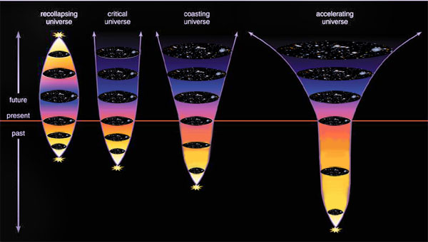
THANK YOU

