Slide 1
Generalized sl(2) Gaudin algebra and corresponding Knizhnik-Zamolodchikov equation
Igor Salom (Institute of Physics, Belgrade)
and Nenad Manojlovic (University of Algarve, Portugal)

Slide 2
Talk based on…
I. Salom, N. Manojlović and N. Cirilo António, Nuclear Physics B 939 (2019) 358–371
…which is based on: N. Cirilo António, N. Manojlović, E. Ragoucy, I. Salom, Nucl. Phys. B 893 (2015) 305–331 and N. Cirilo António, N. Manojlović, I. Salom, Nucl. Phys. B 889 (2014) 87–108
Certainly Mathematical physics, but definitely not cosmology, not even gravity
→ Better start from some basics…
It is a school, after all!

Slide 3
Talk outline
Introduction to algebraic Bethe ansatz
A few words on motivation
Define XXX chain problem
Introduce standard notions (R matrices, Lax operator, monodromy, transfer matrix, Bethe equations)
Solving ABA
Nontrivial boundary conditions
Obtaining Gaudin model
Research results
Relation to Knizhnik–Zamolodchikov equations
Scalar product formulas
Proof of the off-shell form of Bethe vectors

Slide 4
Motivation?
So few problems that we can exactly solve
Any such is precious
The more general, the better
Some models have more or less natural potential application
Explains dominant magnetic behavior
Related to conformal field theories in 2 dimensions
Expected to provide insights to realistic problems
Gaudin model – integrable with long range interactions

Slide 5
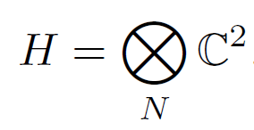
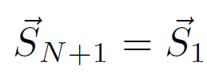
Basic problem – spin chain
Heisenberg spin chain Hamiltonian (nearest neighbor interaction):
Solve = find energies, wave functions, other conserved quantities

Slide 6
Coordinate Bethe ansatz
90 years old approach:
Does solve the main problem, but not allowing easy generalizations
We will not follow this approach

Slide 7
Algebraic Bethe Ansatz (ABA)
Introduce additional auxiliary space and a “Lax operator”:

Slide 8
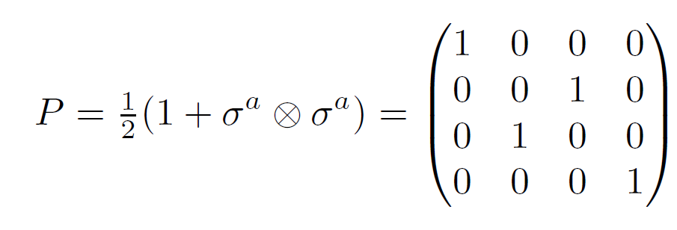
Relation to permutation operator
Lax operator can be written as:
Where P is permutation operator:

Slide 9
How do Lax operators commute?
Consider:
where:
This “RLL” relation or “fundamental commutation relation” can here be confirmed by using:
?

Slide 10
R matrices
These R matrices satisfy the quantum Yang-Baxter equation:
Which can be seen to follow from RLL relation, since:
while also:

Slide 11
Monodromy
Now we define “Monodromy”, that acts on the entire chain:
That can be seen as a 2x2 matrix whose elements are operators on the basic Hilbert space:
From RLL we find how T-s commute, i.e. RTT:

Slide 12
Transfer matrix
The trace:
due to
commutes for different values of the parameter:

Slide 13
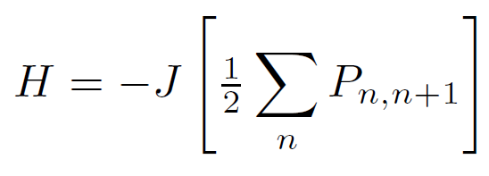
Why is this important?
We have families of mutually commuting operators, e.g. obtained from power series expansion. And one of such operators is the Hamiltonian! From:
one obtains:
which is proportional to the Hamiltonian:
also:

Slide 14
Solving the transfer matrix eigenproblem
If we know eigenvalues of the transfer matrix t(u), we know values of all conserved quantities!
First we show that is an eigenstate:
thus:
also we note:

Slide 15
The rest of eigenvectors?
We show that these are obtained by action of B operators.
First we neeed “commutation” relations:

Slide 16
From the commutation relations…
If we define vectors:
we obtain “off-shell” action:
unwanted terms
= 0
eigenvalue
Bethe equations

Slide 17
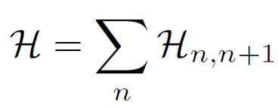
But the approach is far more general!
Each R matrix satisfying Yang-Baxter equation defines an integrable spin chain!
If and
It is proved following the same procedure:
Yet, it is not easy to solve the t eigenproblem

Slide 18
Research generalizations
Inhomogeneous chain:
Interaction does not have to be isotropic
Nonperiodic, more general boundary conditions
Extension to long range interaction (Gaudin model)
More (KZ equations, scalar products)
XXZ chain
XYZ chain

Slide 19
XXZ chain
R matrix
Arbitrary spin:
U_{q}(sl(2))
generators

Slide 20
Nontrivial boundary conditions
Introduce 2x2 matrices K⁺ and K⁻ that parameterize boundary conditions
Following Sklyanin, these must satisfy “reflection” equations:

Slide 21
New monodromy matrix
It incorporates boundary conditions:
where:
satisfying

Slide 22
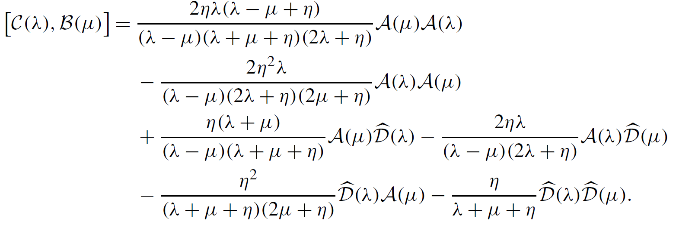
Commutation relations

Slide 23
Transfer matrix
The transfer matrix is now constructed as:
and corresponds to Hamiltonian:
introduces huge complications
nontrivial boundary terms

Slide 24
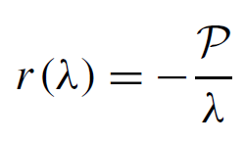
Gaudin model
It turns out that we can obtain a related integrable model by considering expansion series (in “eta”):
“Classical” Yang-Baxter
Yang-Baxter

Slide 25
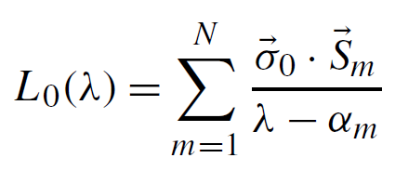
Chain to Gaudin connection
Lax operator:

Slide 26
Chain to Gaudin connection
Monodromy and transfer matrix
This does not lead to nice/useful expressions…

Slide 27
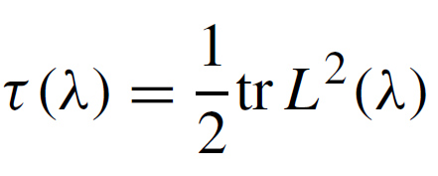
We correct it by a trick…
There is a central element:
We redefine transfer matrix:

Slide 28
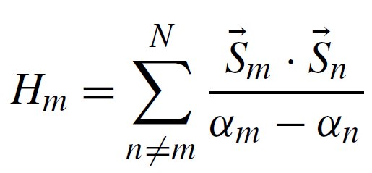
Long range Hamiltonians
New transfer matrix can be written as:
where Hamiltonians we choose as the residues at poles:
long range, not merely nearest neighbors!

Slide 29
Non-periodic boundary
In a long and painful procedure, we can repeat everything with nontrivial boundary conditions:
…
…
…

Slide 30
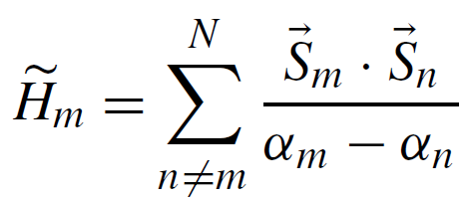
New, more general Hamiltonians
Again obtained as residues…
nontrivial boundary terms

Slide 31
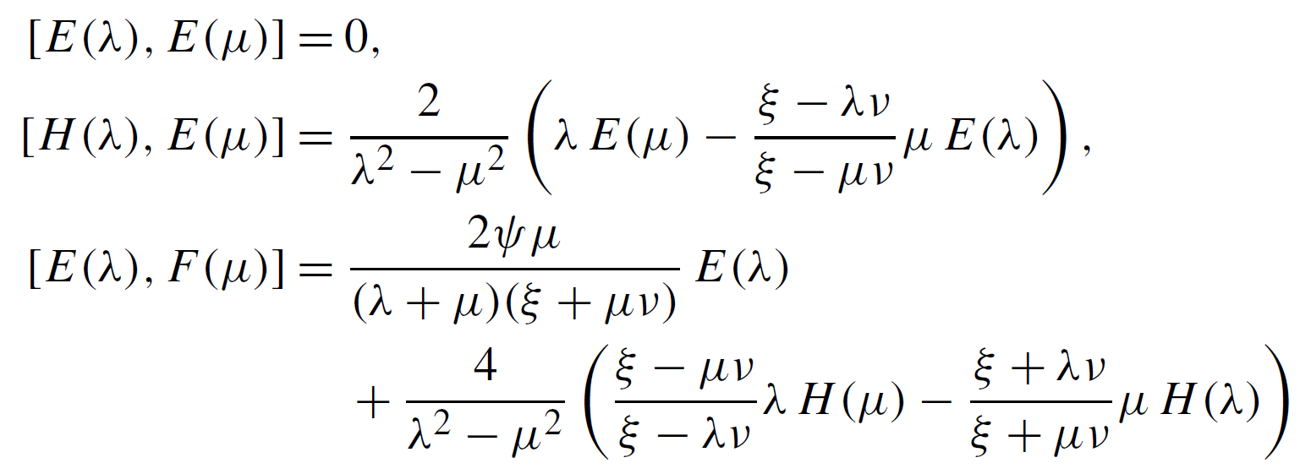
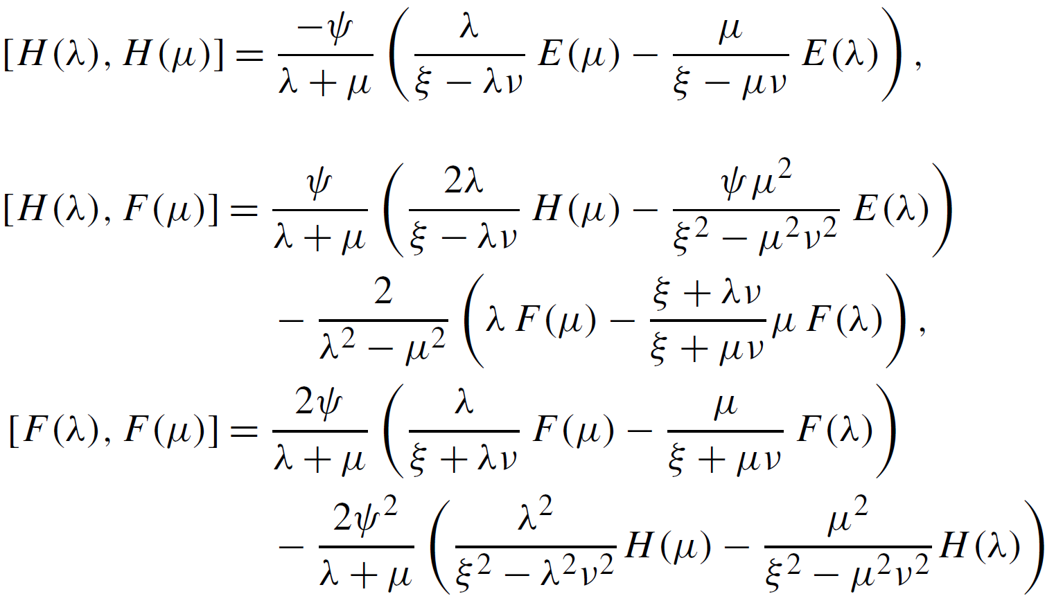
Solving = Algebraic Bethe Ansatz
similar idea as before…
Horrible relations…

Slide 32
…how to simplify them?
After the second attempt to find (E,F,H) → (e,f,h):

Slide 33
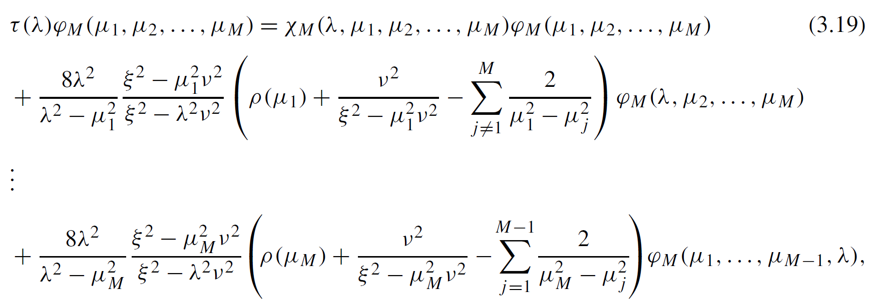
Now: solution + analytic proof
Bethe vectors:
eigenvalues:
=0 ← Bethe equations

Slide 34
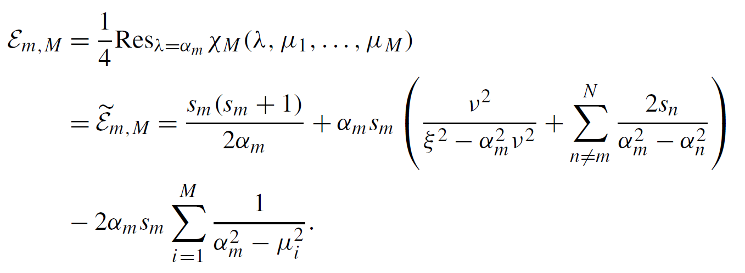
Now we can read energies

Slide 35
Knizhnik–Zamolodchikov equations
By introducing:
we recognize that the new function satisfy equations of Knizhnik–Zamolodchikov form (B. Feigin, E. Frenkel, N. Reshetikhin, Com. Math. Phys. 166 (1994) 27–62):

Slide 36
Scalar product formulas
On shell (i.e. Bethe eqs. satisfied):
Off-shell:

Slide 37
Summary
We have shown:
ABA construction
How to include nontrivial b.c. in a spin chain
How to get Gaudin as the limit (expansion)
How to include nontrivial b.c. in Gaudin
Proper operators lead to solution of Gaudin ABA
Eqs. of KZ form are demonstrated to hold
Demonstrated norm/scalar product formulas

Slide 38
Thank you.

Slide 39
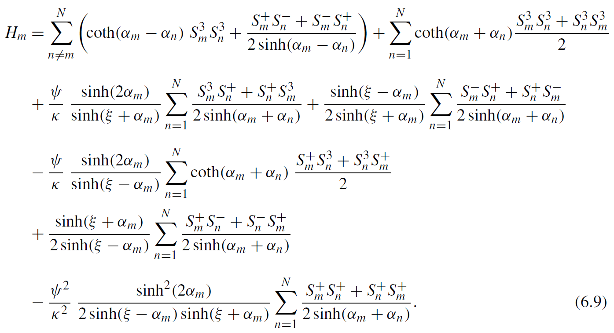
1. XXZ Gaudin model
It turns out that we can proceed from here to solve some long range interaction Hamiltonians (“Gaudin”):
Additional richness originating from boundary terms
“long range” interaction

Slide 40
Expansion in eta…
Skipping some mathematical details:
Now that:

Slide 41
i) Solving the eigenproblem using the spin chain Bethe vectors
We may expand previously obtained Bethe vectors:
and find off-shell equations:

Slide 42
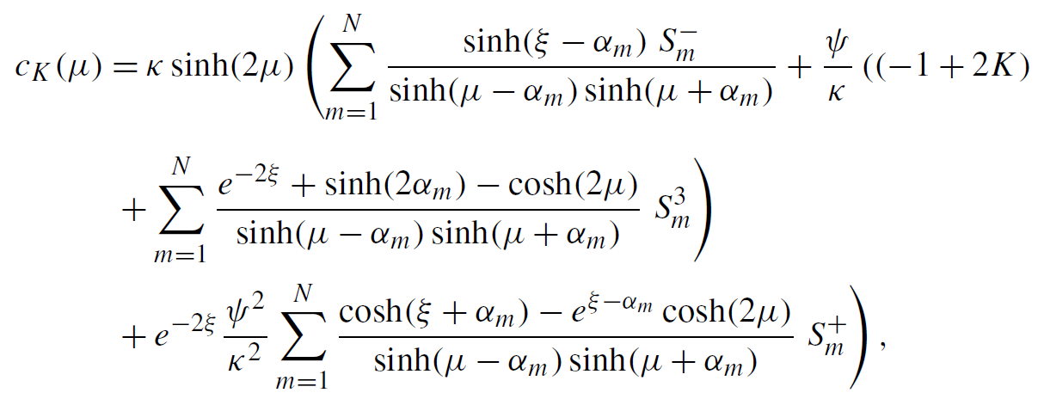
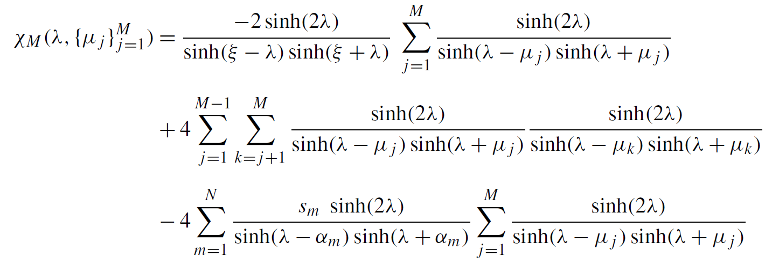
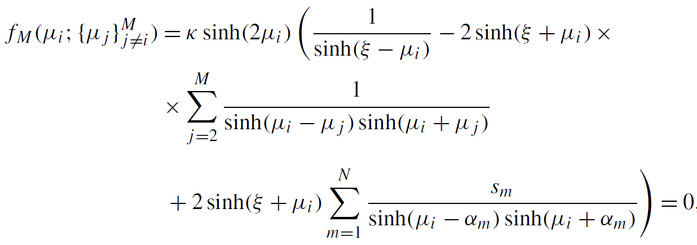
…where:

Slide 43
ii) Solving the Gaudin model independently
“Classical” equivalents:
r matrix
satisfying classical Yang-Baxter equation
Gaudin Lax matrix
Obeying Sklyanin linear bracket relation (equivalent of RLL):

Slide 44
Reflection matrix related steps
Introduce:
satisfying:
then:
and:
so that:

Slide 45
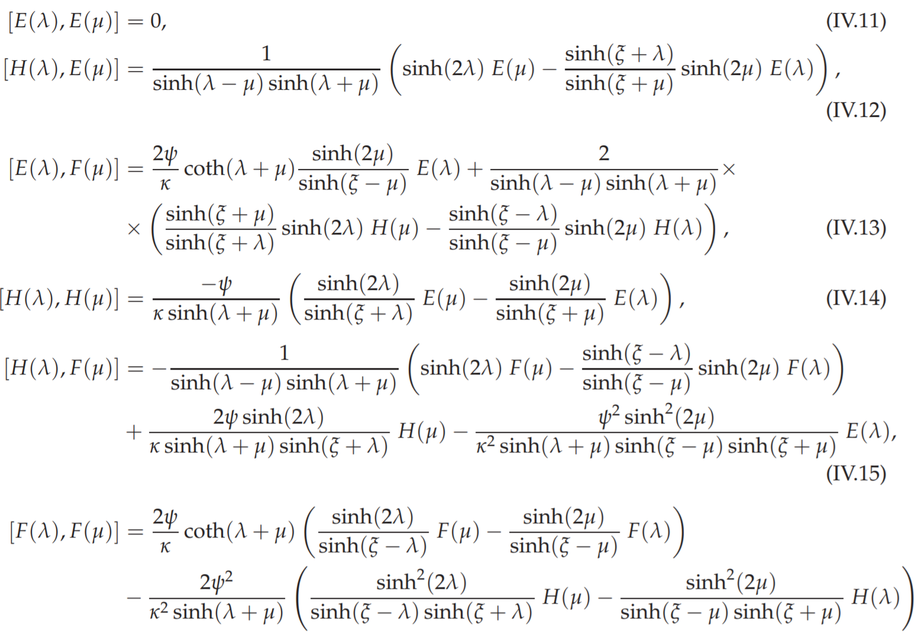
Commutation relations
Denoting:
With φ=0 we find:

Slide 46
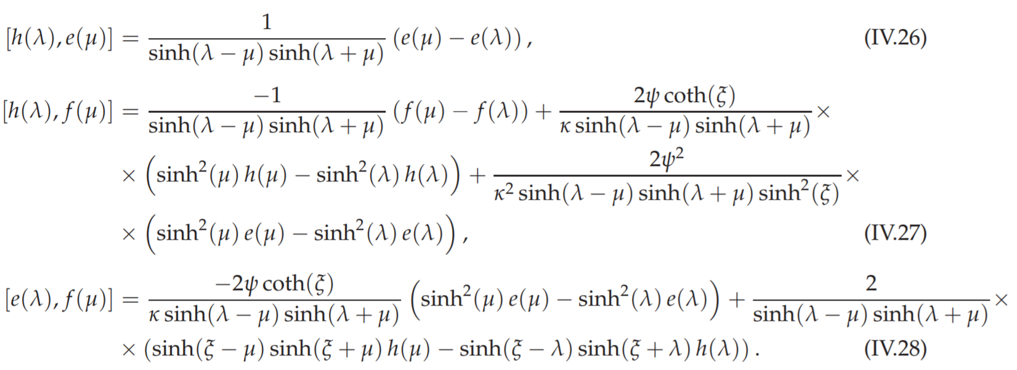
Change of variables

Slide 47
We find the eigenvectors in terms of the new operators:
Introduce a class of creation operators:
then we can write solutions as:

Slide 49
Finding Bethe vectors - vacuum
Start with vacuum:
where and we set φ=0

Slide 50
First order excitation
One magnon excitation vector:
eigenvalue
unwanted terms
Bethe equations

Slide 51
However, there is a freedom…
Due to the following relation:
There is actually a whole class of solutions, satisfying identical off-shell equation:
This is a generic feature, we don’t know it was discussed before!

Slide 52
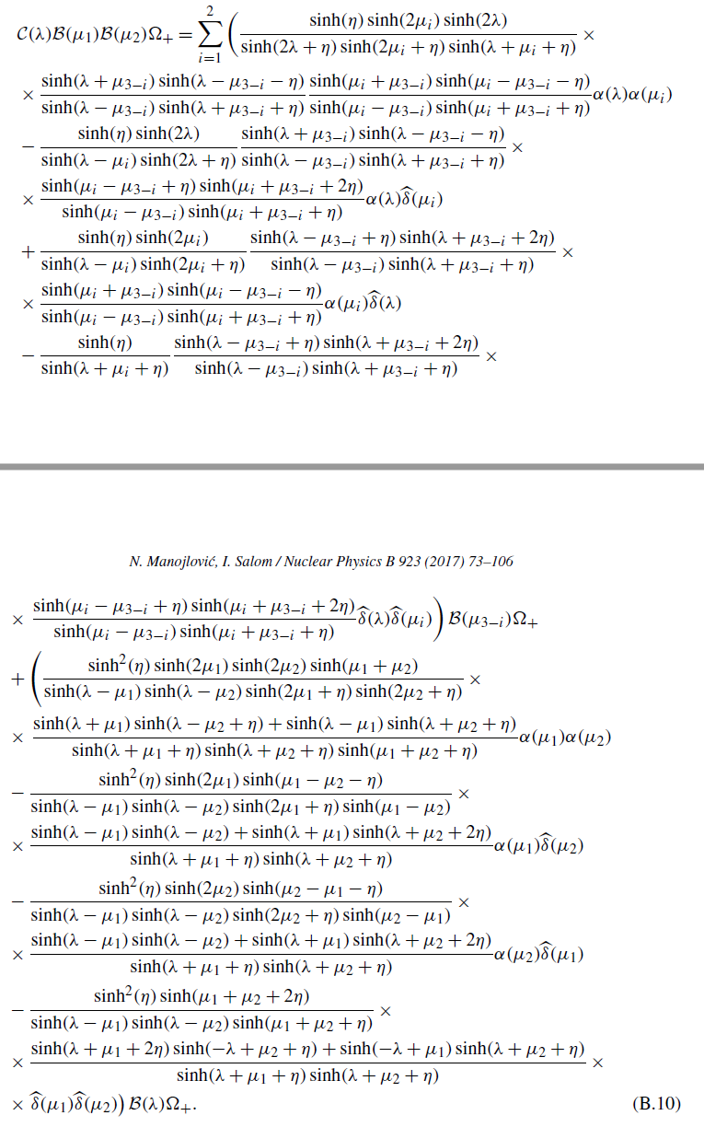
Second order excitation
One of intermediary steps

Slide 53
It satisfies off-shell equation:

Slide 54
But also does:
which is a consequence of identities:

Slide 55
General solution

Slide 56
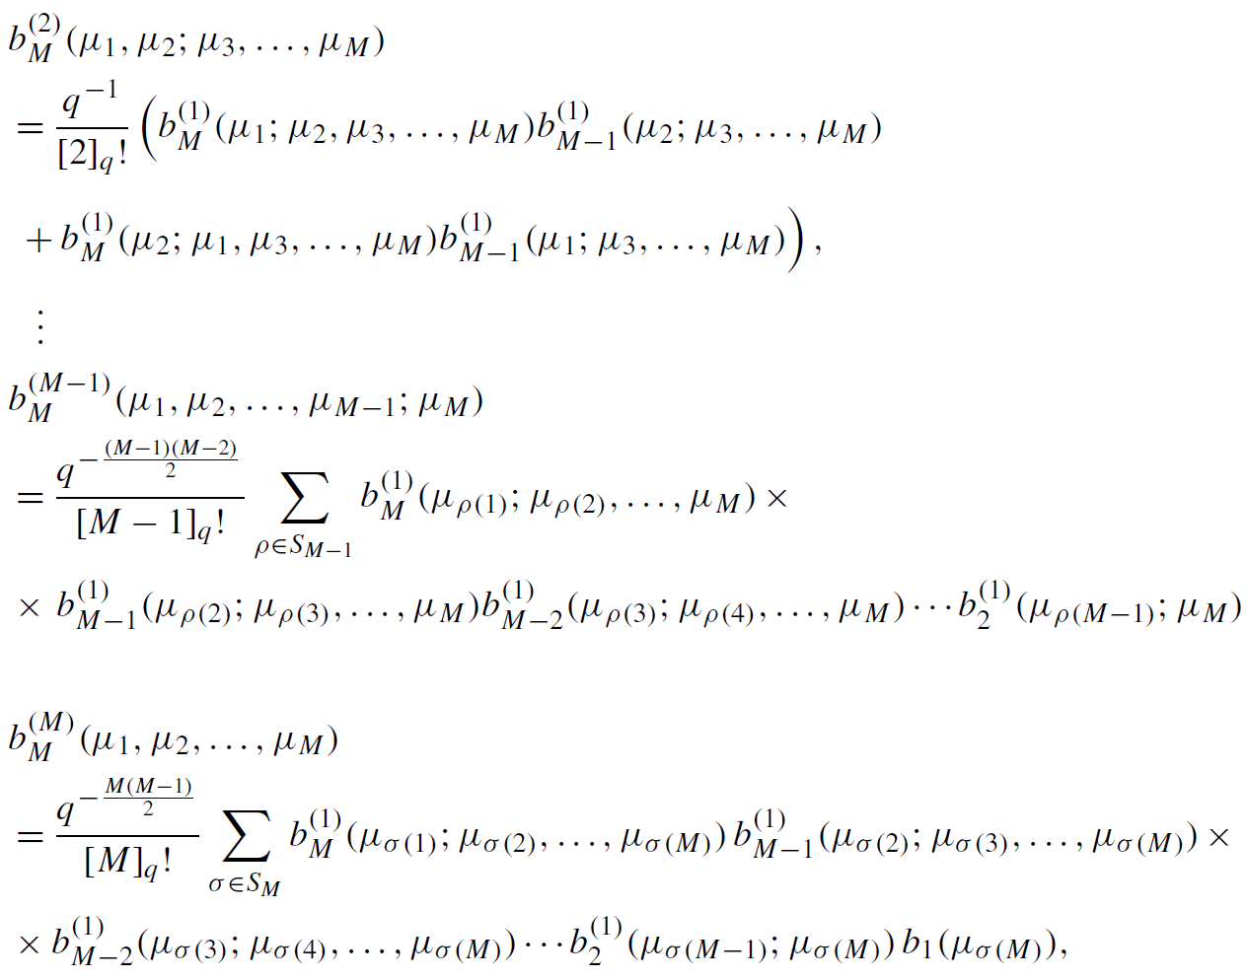
…

Slide 57
Off shell action:

Slide 58
Conclusion
We illustrated the ABA method
Following that approach, we have solved a spin-chain model with anisotropy and non-periodic boundary condition
We pointed out the degrees of freedom that appear in off-shell solutions
We set up the stage to derive another model, of long range interactions – Gaudin model…

Slide 59
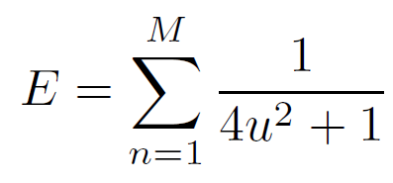
Connection with physical entities
Rapidities u_{i} are related to momenta of “magnons”
And the formula for energy:

Slide 60
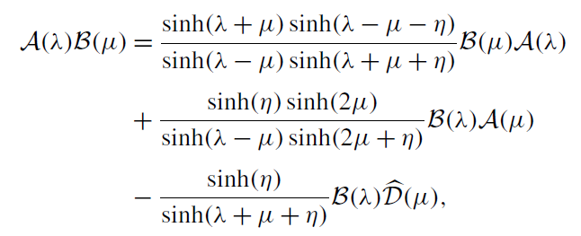
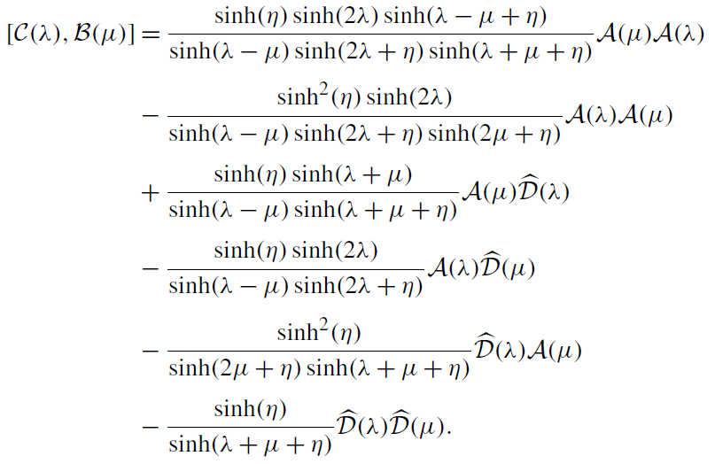
Commutation relations

Slide 61
Nontrivial boundary conditions
Introduce 2x2 matrices K⁺ and K⁻ that parameterize boundary conditions
Following Sklyanin, these must satisfy “reflection” equations:

Slide 62
Transfer matrix
The transfer matrix is now constructed as:
and corresponds to Hamiltonian:
XXZ anisotropy
nontrivial boundary terms

Slide 63
Transfer matrix
The transfer matrix is now constructed as:
and corresponds to Hamiltonian:
nontrivial boundary terms

Slide 64
Transfer matrix
The transfer matrix is now constructed as:
In principle, we nevertheless follow the same path as before…
introduces huge complications

